Slide 1
ENVIRONMENTAL PERSPECTIVES: ARGENTINA & THE UNITED STATES
Anya Meave | Ebone Fletcher |
Marieke Smits | Natalie Muyres
ANTH 5041
Quantitative Methods in Anthropology
Final Project April 2021

Slide 2
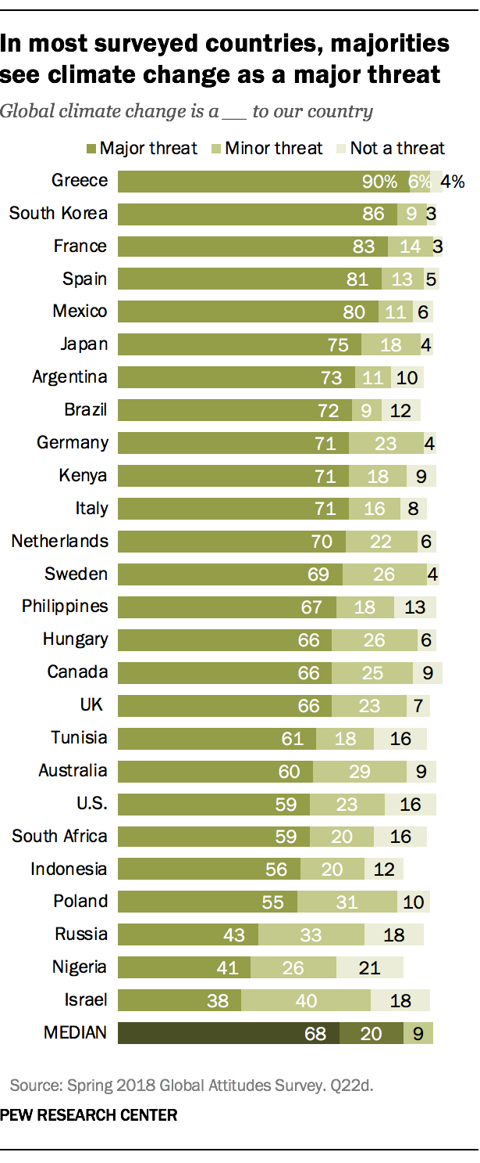


Overview
Research Question:
Which country values the environment more, Argentina or the United States? What variables are associated with caring for nature and saving life resources?
Hypothesis:
Countries with less prominent neoliberal values are more likely to self-identify with caring for the environment as compared to countries with stronger neoliberal beliefs.
Notes:
Natalie Muyres
According to a 2018 Pew Research survey on climate change, citizens in the United States are less concerned about climate change than those in many other countries, including Argentina. The United States ranked 7 of 26, while Argentina ranked in the top 25th quartile, or 7 of 26 countries.
Argentina, a Latin American country, was chosen as a comparison field site in preparation for field work planned that will explore climate change practices in comparison to the United States.
This presentation will summarize the research findings that explored several values in the World Values Survey to test the stated hypothesis - how neoliberal ideology influences beliefs about environmental protections.
Neoliberalism is defined as a “policy of supporting a large amount of freedom for markets, with little government control or spending, and low taxes. Many neoliberalism policies enhance the workings of free market capitalism and attempt to place limits on government spending, government regulation, and public ownership” (dictionary.cambridge.org).
Neoliberal ideology is related to individualist values like personal gain, autonomy, and self-reliance – the individual, rather than the group, is the priority.
In total 47 variables were tested, 34 of them showed significance between the dependent variable for either one or both countries.
Variables with significance were grouped into six themes: environment, politics, science and technology, economics, religion and life purpose, and personal and family values.
The presentation will highlight the most significant findings.

Slide 3
Caring for Nature and Life Resources
Compared to the United States, Argentinians are significantly more likely to identify with others who care for the nature and want to save life resources, p<.05
Argentina
M = 2.72
N = 1014
United States
M = 2.95
N = 2190
Very Much Like Me
Not At All Like Me
1
2
3
4
5
6
Looking after the environment is important to this person
Notes:
Natalie Muyres:
An independent T-test was run for both countries as compared to the dependent variable, “looking after the environment is important to this person”
The dependent variable is a continuous variable, and scores lower on the scale identify with caring for the environment and scores higher on the scale do not
Consistent with the 2018 Pew Research findings, Argentinian respondents identified more strongly with caring for the environment than American’s, and the results were statistically significant (p=<.001)

Slide 4
Environment
AR N=1015; U.S. N=2190; p<.05
All four variables in this section were found to have significance.
Participants often connected with environmental organizations but did not always have confidence in them or believe pollution is a problem.
Notes:
Anya Meave:
All variables in this section (V30, V80, V82, V122) were found to carry significance.
In both Argentina and the United States, participants were found to be more likely to be an active member of an environmental organization, but the U.S. displayed a slightly higher mean (M=1.64) as compared to Argentina (M=2.03).
A Chi-Square test conducted found that residents in the U.S. were more likely to give money to an ecological organization (29%) as compared residents in Argentina (14%).
Participants in both countries did not think pollution was the worst problem in the world, but the United States reflected a higher mean of disagreement (M=3.0) with this variable than Argentina (M=2.7).
A one-way ANOVA test was conducted to identify the significance between confidence in environmental organization in both Argentina and the United States. The test revealed that in both countries, participants had less confidence in environmental organizations with the U.S. displaying a higher mean (M=3.34) than Argentina (M=3.03).

Slide 5
POLITICS: Political Activities
AR N=1015
U.S. N=2190
p<.05
Significance was found between both variables for both countries
In this section of the study the findings suggest that those that report participation in political activities in both Argentina and the U.S. are significantly more likely to care for the environment.
Very Like Me Mean Scale Not l Like Me
Notes:
Ebone Fletcher
Both variables V85 signing a petition and V83 participating in a demonstration for some environmental cause were operationalized as political activities.
It was hypothesized that respondents that reported participation in political activities in both Argentina and the U.S. would be significantly more likely to care for the environment.
Both variables were found to be significant. The lower the mean value on the scale the more the concern for the environment.
V85 signing a petition US: Those who identify with caring for the environment are significantly more likely to “Have done” (M=2.86). Argentina: Those who identify with caring for the environment are significantly more likely to “Have done” (M=2.22)
V83 participating in a demonstration for some environmental cause. Argentina: Yes Mean: 1.99; U.S. : Yes Mean: 2.07

Slide 6
POLITICS: Political Interest
AR N=1015
U.S. N=2190
p<.05
Significance was found between both variables for both countries
Participants that express interest in politics are also likely to look after the environment, care for nature, and save life resources in both countries.
AR N=999
U.S. N=2181
p<.05
% Percentage Environmental Support
Notes:
Ebone Fletcher
The variables for V84 “How interested would you say you are in politics” and V7 “How important would you say politics is in your life?” were operationalized as interest in politics.
Both variables were found to be significant in the U.S. and Argentina. The findings suggest that participants that express interest in politics are also more likely to look after the environment, care for nature, and save life resources in both countries.
Independent T-Test Argentina: V84 (M= 2.51) United States: V84 (M= 2.8) The lower the mean value on the scale the more the concern for the environment.
Chi Square Test Argentina: V7 (Very Much Like Me) 12.2% X2 (15, N = 999) = 49.7, p = .000 United States: (Very Much Like Me) 25.8% X2 (15, N = 2181) = 55, p = .000

Slide 7
POLITICS: Political Views
AR N=1015
U.S. N=2190
p<.05
Significance was found between all three variables for both countries
Participants in both Argentina and the United States who identify with “left” leaning political views are also more likely to self-identify as caring for the environment
Very Like Me Mean Scale Not Like Me
Notes:
Ebone Fletcher
Participants that answered “Very Good” for V130, “disagree” for V51, and “Agree” for V48 were operationalized as displaying a “left” leaning political view and hypothesized as more likely to identify with caring for the environment in both countries.
All three variables were found to be significant. The lower the mean value on the scale the more the concern for the environment.
The variables tested consisted of V130 “Is having a democratic political system [way of governing a country]”, V51 “On the whole, men make better political leaders than women do”, and V48 “Having a job is the best way for a woman to be an independent person”.
U.S. : V130 (M=2.9), V51 (M=2.9), V48 (M=2.9) Argentina: V130 (M=2.68), V51 (M=2.7), V48 (M=2.6)

Slide 8
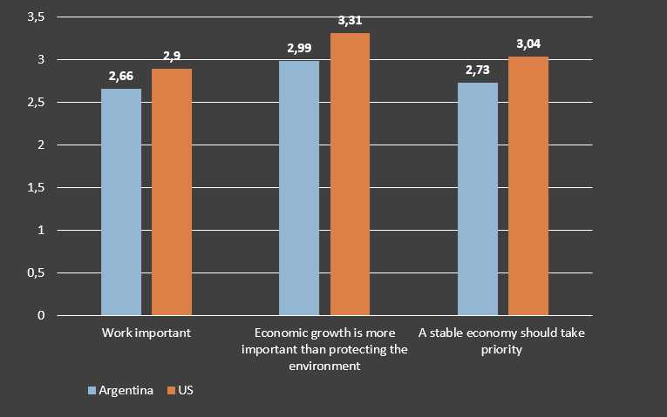
Economy
AR N= 958
U.S. N= 2162
p<.05
Significance was found between all three variables – with one variable only being significant for the US.
As hypothesized, prioritizing the economy correlates negatively with the extent to which Americans and Argentinians identify with being caring for nature.
Interestingly enough, people that valued work as important also reported to adhere more importance to nature.
(Lower mean values relate to greater care for the environment)
Notes:
Marieke Smits
An independent T-test was run for both countries for the first two variables after recoding the independent variable for it to be dichotomous (ie: work important: yes/no). To test significance for non-dichotomous independent nominal variable number three ("a stable economy should take priority") a One-Way ANOVA test was run.
The dependent variable was kept continuous and ranks self-reported levels of being caring of nature and natural resources on a scale from 1 – 10 with a lower score indicating a higher level of environmental consciousness.
Both Americans and Argentinians that deem economic growth to be more important than the environment indicate to be less caring towards nature. Of both groups, Americans report the lowest levels of being caring for nature.
American respondents that reported that a stable economy should be given priority over other causes in general (such as progress towards a more humane society, progress towards a society in which ideas and count more than money and the fight against crime) returned significantly higher scores indicating lower levels of environmental consciousness. There was a statistically significant difference between groups as determined by one-way ANOVA (F(3, 2169) = 16.2, p=,.001). A Tukey post hoc test revealed that those valued a stable economy (M=3.04 +/- 1.28) were significantly less likely to report to be caring towards nature than respondents that prioritized a more humane society (M= 2.45 +/- 1.18) or progress towards a society in which ideas and count more than money (M= 2.65 +/- 1.27). This confirms our hypothesis that American people with a more neoliberal outlook (in which economic benefits take absolute priority) are generally less inclined to be caring for nature. This is consistent with the 2018 Pew Research findings which states that Argentinian respondents identify more strongly with caring for the environment than Americans.
For variable number one ("Is work important to you in life") significance was found. However, the findings showed a positive correlation between work being valued and being caring for nature (people that indicated to value work also reported higher levels of being caring for nature). Although one could argue that this rejects our hypothesis, more research is required as valuing work is not the best way to operationalize support of neoliberal ideas. (One could value work but not be neoliberally inclined).

Slide 9
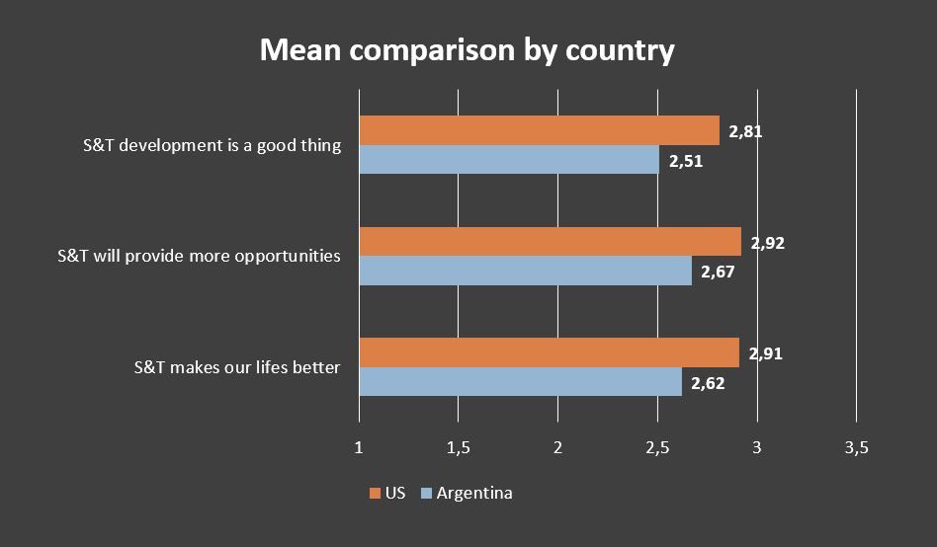
Science & Technology
AR N= 981
U.S. N= 2139
p<.05
All 3 variables related to science & technology were significant in both countries.
People that see scientific and technological development in a positive light, are more likely to self-report as being caring for nature.
In Argentina the strongest correlations were found across all three variables.
(Lower mean values relate to greater care for the environment)
Notes:
Marieke Smits
Independent T-tests were run for both countries safter recoding the independent variables to be dichotomous (ie: S&T is a good thing: y/n).
The dependent variable was kept continuous and ranks self-reported levels of being caring of nature and natural resources on a scale from 1 – 10 with a lower score indicating a higher level of environmental consciousness.
Both Americans and Argentinians with a positive stance towards scientific and technological development reported significantly lower scores (indicating higher levels of being caring for nature).
Argentinians reported to be more caring of the environment across the board. This is consistent with the 2018 Pew Research findings which states that Argentinian respondents identify more strongly with caring for the environment than Americans.

Slide 10
Religion and Life Purpose
AR N=1015
U.S. N=2190
p<.05
Three of four variables displayed significance in this section.
Participants that value the environment did not consider purpose of life, nor believe their religion was the only acceptable religion. Participants in the U.S. somewhat agreed we depend too much on science rather than faith.
Notes:
Anya Meave:
There were a total of three variables in this section (V143, V154, V194) that were found to carry significance.
The perception of human dependence on science and not faith was found to be significantly different between both Argentina and the United States. Participants in Argentina displayed no significance across the board while the U.S. somewhat agreed (M=3.09) that we depend too much on science and not enough on faith.
A Chi-Square test revealed that Argentinians were 33% more likely to disagree their religion was the only acceptable religion. This percentage was slightly higher than the United States where 28% of participants that disagreed their religion was the only acceptable religion.
Participants in Argentina and the United States rarely thought about the meaning of life. The U.S. displayed a higher mean (M=3.3) than Argentina (M=2.89) on a scale of looking after the environment and caring for nature while saving life resources.

Slide 11
Personal and Family Values
3 of 8 variables related to personal and family values were significant in both countries – but no over-arching pattern identified
Lower mean values relate to greater care for the environment, p=<.05
Notes:
Natalie Muyres
Of the 34 variables that showed significance, 8 of them represented personal and family values, 3 of the 8 variables were significant in both countries.
The graph shows the 3 variables that were significant in both countries (p=<.05). The other 5 variables were only significant in the United States.
Immigration: The environment was valued if both parents of Argentinians were immigrants, but only if fathers were immigrants to Americans. It can be hypothesized that values about the environment have been passed to children of immigrants.
Immigrants in both countries are normally from neighboring and poorer countries where neoliberal policies have caused disruptions to government, social supports, and job markets. Mass agriculture by multinational corporations and deregulation is an example. More research is needed to investigate the link between immigration and care for the environment in origin countries impacted by neoliberal policy and actions.
“Unselfishness”: Argentinian and American respondents who mentioned being “unselfish” as an important characteristic to teach children were equally likely to identify with caring for the environment. However, not shown on the slide, in Argentina, those who did not mention “unselfishness” identified with caring for the environment even more (m=2.6 vs. m=2.9). Unselfishness is translated as “generous” in Spanish, the primary language in Argentina. Are the results related to translation? Or are Argentinian’s less ”individualist” in general and caring for the environment is common.
Leisure: Lastly and not surprising, both countries reported a greater care for the environment when they also valued leisure time. Leisure time can include being in nature and can also be related to community values. Neoliberal values of profit at all costs and deregulation can have negative impacts on the environment.
It appears each of these significant variables support the hypothesis that environmental care may be related to less prominent neoliberal values (p=<.05).

Slide 12
Summary of Findings
Immigrant parents may pass on their concern for the environment to their children. This could be related to neoliberal policy in origin countries.
Participants that reported a significant interest in politics, political activities and left leaning political views, were more likely to care for the environment in both countries. This suggests a relationship between politics and environmental support.
Participants in both countries actively engage with and support environmental organizations but lack sincere trust in such groups.
Respondents that favor caring for nature do not ponder the meaning of life or feel only one religion is critical.
Notes:
When both parents of Argentinian respondents and fathers of American respondents are immigrants, the respondent is more likely to care for the environment (p=<.05). Immigration in Argentina is predominately from neighboring poorer countries like Paraguay and Bolivia, and in the US, from Mexico. It can be hypothesized that immigration is influenced by access to jobs, land rights, and environmental impacts by large corporations and deregulation in the origin country. It appears immigrant parents pass on their care for the environment to their children, but more research is required. (Natalie)
Participants in both countries with a significant interest and engagement in politics were found to report more environmental support. However, Argentina was shown to be more supportive of caring for the environment in all the politically related tests shown here when compared to the United States. (Ebone)
Participants in both Argentina and the United States were more inclined to contribute time and money to environmental organizations. However, their actions did not equate to having faith in the groups wholeheartedly. (Anya)
Respondents that favor looking after the environment in both countries did not agree that only one religion reigns supreme, nor that it is important to ponder the meaning of life. Additionally, although not significant in Argentina, participants in the United States slightly agreed that humans depend too much on science and not enough on faith. (Anya)

Slide 13
Recommendations
Gender/sex and age would be helpful to investigate variables further.
More research is needed to investigate the link between immigration and care for the environment in origin countries impacted by neoliberal policy and actions.
Survey rural and urban residents to understand how their personal beliefs align with the notion of caring for the environment.
Researching occupation type may help indicate a connection between sector and environmental importance.
Further study of the differences in political structure between Argentina and the U.S. is needed to determine why there is such a strong link between politics and environmental support in both countries yet, Argentina takes the lead in environmental care.
Notes:
The research team did not find any correlations between variables, but feel that gender/sex and age might be a way to analyze the data further and may find correlation between variables using demographics. (Natalie)
Immigrant parents seem to pass on a care for the environment. Origin country dynamics, including neoliberal policies or existing values about the environment could be investigated further as contributing factors. (Natalie)
Researchers may consider surveying residents in rural and urban areas to understand how their personal beliefs align with the notion of looking after the environment and caring for nature while saving life resources to further understand if both countries share similar views based on geographic area. (Anya)
Adding occupation type to the survey may help researchers understand the relationship employees in various lines of work have with the environment and whether they deem looking after the environment and caring for nature a priority. (Anya)
The survey could include questions that specifically address the political structure in Argentina to better understand why politics is so closely tied to caring for the environment. (Ebone)

